Slide 1

PCSE214- MOBILE APPLICATION DEVELOPMENT
CHAPTER IV
UI CONTROLS
By: Mr. Tobias Kakooza.
Professional Certificate in Software Engineering

Slide 2
OBJECTIVES
Understand Basic UI controls and their purpose
Describe the life cycle of UI
Define how to access controls server-side

Slide 3
DEFINITION
Input controls are the interactive components in your app's user interface. Android provides a wide variety of controls you can use in your UI, such as buttons, text fields, seek bars, check box, zoom buttons, toggle buttons, and many more.
A View is an object that draws something on the screen that the user can interact with and a ViewGroup is an object that holds other View (and ViewGroup) objects in order to define the layout of the user interface.
You define your layout in an XML file which offers a human-readable structure for the layout, similar to HTML. For example, a simple vertical layout with a text view and a button looks like this −

Slide 4
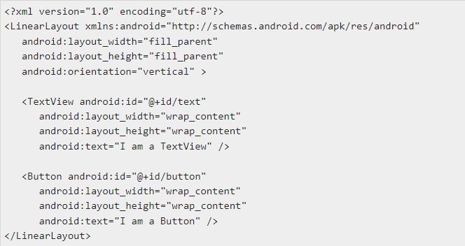
DEFINITION CONTD…

Slide 5
UI Controls List
There are number of UI controls provided by Android that allow you to build the graphical user interface for your app.
Sr.No. UI Control & Description
1 TextView
This control is used to display text to the user.
2 EditText
EditText is a predefined subclass of TextView that includes rich editing capabilities.
3 AutoCompleteTextView
The AutoCompleteTextView is a view that is similar to EditText, except that it shows a list of completion suggestions automatically while the user is typing.

Slide 6
UI Controls List contd…
4 Button
A push-button that can be pressed, or clicked, by the user to perform an action.
The DatePicker view enables users to select a date of the day.
5 ImageButton
An ImageButton is an AbsoluteLayout which enables you to specify the exact location of its children. This shows a button with an image (instead of text) that can be pressed or clicked by the user.
6 CheckBox
An on/off switch that can be toggled by the user. You should use check box when presenting users with a group of selectable options that are not mutually exclusive.

Slide 7
UI Controls List contd…
7 ToggleButton
An on/off button with a light indicator.
8 RadioButton
The RadioButton has two states: either checked or unchecked.
9 RadioGroup
A RadioGroup is used to group together one or more RadioButtons.

